Slide 1



Slide 2
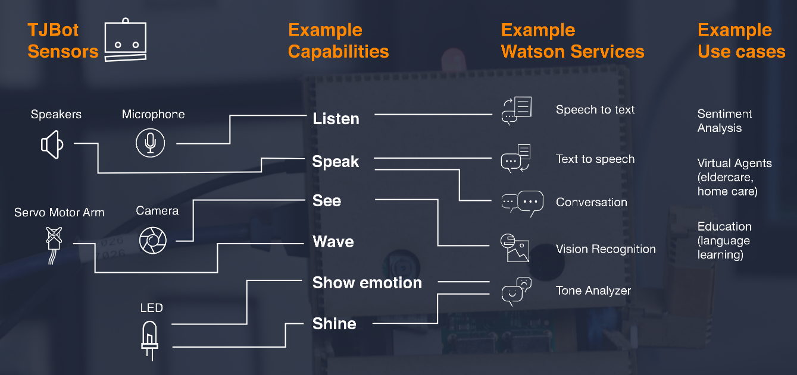

TJBot’s capabilities

Slide 3
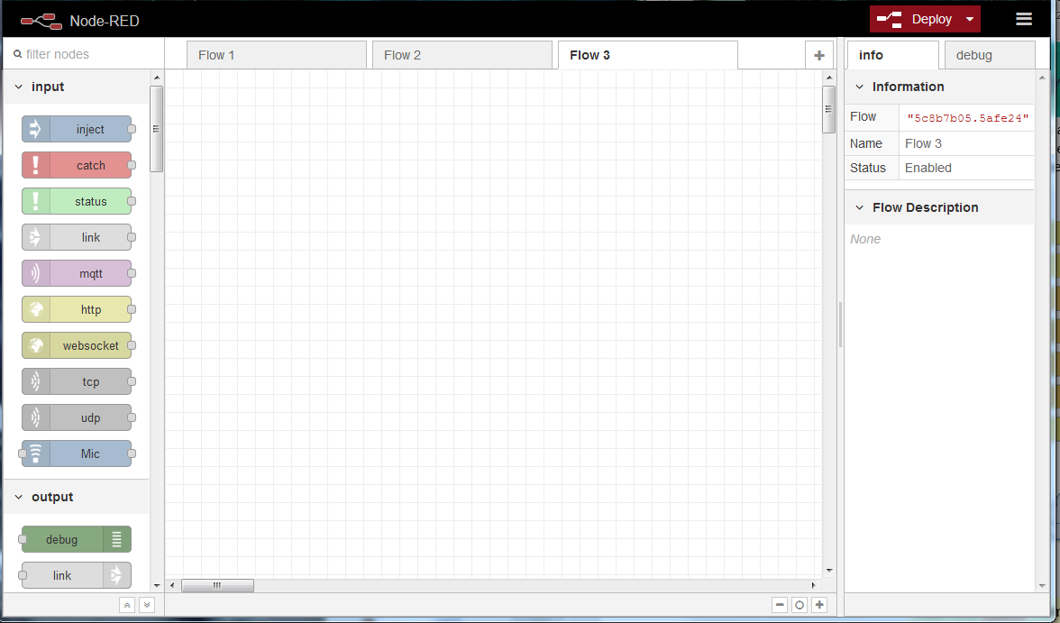
Node-Red – Connect to TJBot Node-Red flow editor
(http://ipaddress:1880)

Slide 4
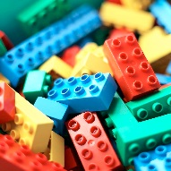

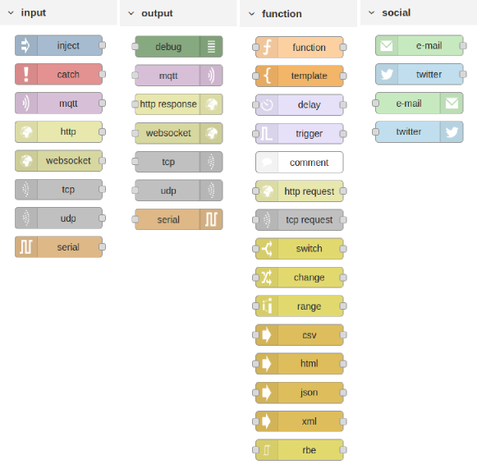
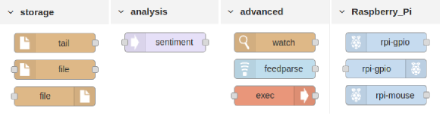
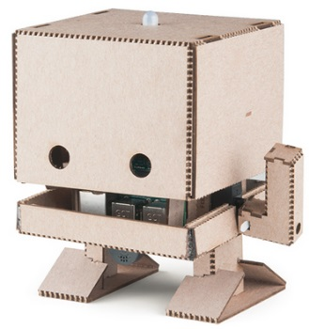
Node-RED is a flow-based development tool developed by Nick O’Leary and Dave Conway-Jones of IBM’s Emerging Technology Services group for wiring together hardware devices, APIs and online services as part of the Internet of Things. Node-RED coding is performed by a browser-based flow editor.
Basic Nodes
I like it!
Add new nodes from palette or create new ones.
Notes:
There’s a whole community out there
The runtime is built on Node.js. The flows created in Node-RED are stored using JSON.
Elements of applications can be saved or shared for re-use.
It was open-sourced in September 2013, now managed by JS Foundation.
Node-Red is now preinstalled on Raspian and it’s very easy to add new types of nodes (palette). E.g. Just add node-red-node-watson to palette to access IBM Watson Services available on Cloud.

Slide 5
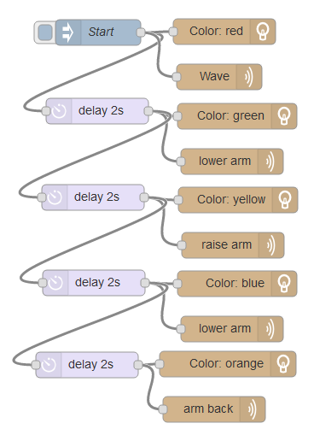
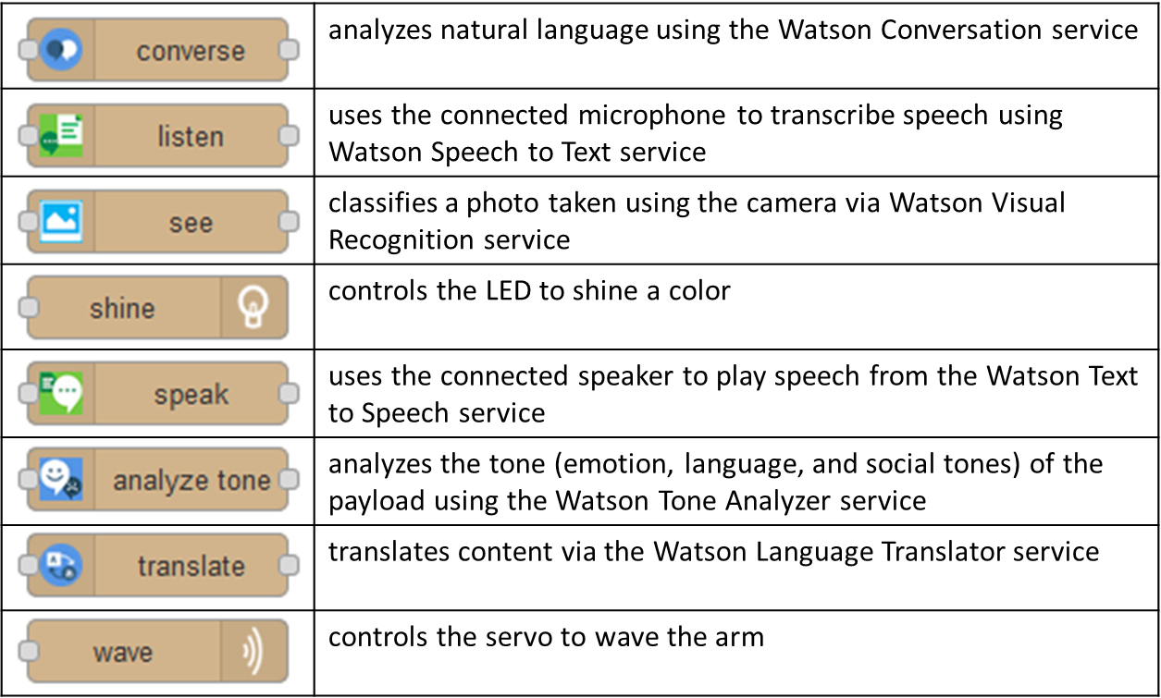
In August 2017, JeanCarl Bisson, created Node-RED nodes for TJBot
Add node-red-node-watson to palette to access IBM Watson Services available on Cloud.
Notes:
Nodes include:
analyze tone - analyzes the tone (emotion, language, and social tones) of the payload using the Watson Tone Analyzer service
converse - analyzes natural language using the Watson Conversation service
listen - uses the connected microphone to transcribe speech using Watson Speech to Text service
see - classifies a photo taken using the camera via Watson Visual Recognition service
shine - controls the LED to shine a color
speak - uses the connected speaker to play speech from the Watson Text to Speech service
take photo - captures a photo taken using the camera
translate - translates content via the Watson Language Translator service
wave - controls the servo to wave the arm

Slide 6
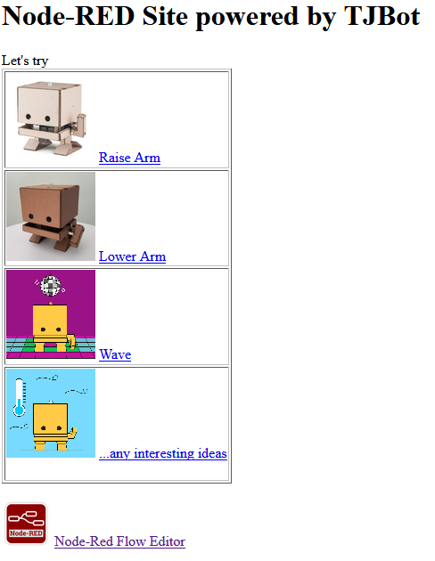
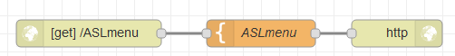
Lab 0 - Create a very simple web site hosted by TJBot
Template content is available on your PC ;)
Too Easy! I can do it!
What happen when you press one of the links available on page? WHY???
Notes:
<html><head><title>MENU - Visual recognition Examples FM with ASLTJBot</title></head><body><h1>Node-RED Watson Visual Recognition MENU</h1><p>Examples:<br/><table border='1'><tr> <td> <img src="https://images.pexels.com/photos/145939/pexels-photo-145939.jpeg" height='100'/> <a href="/reco">Show how IBM Watson Image Recognition works</a><br/> </td> <td> <img src="https://www.nature.com/polopoly_fs/7.41086.1481708999!/image/feature1.jpg_gen/derivatives/landscape_630/feature1.jpg" height='100'/> <a href="/faces">Show how IBM Watson Face Recognition works</a><br/> </td></tr><tr> <td> <img src="https://cdn.sparkfun.com//assets/parts/1/2/5/8/8/14515-04.jpg" height='100'/> <a href="/shot">Shot and Recognize objects using TJBot camera</a><br/> </td> <td> <img src="http://www.rttnews.com/ArticleImages/USTopStories/2016/December/IBM-Robot-122916-lt.jpg" height='100'/> <a href="/what">Last recognized objects from TJBot camera</a><br/> </td></tr><tr> <td> <img src="http://aiclubs.org/uploads/1/0/7/3/107309405/published/img-5972.jpeg?1510622717" height='100'/> <a href="/knock">Shot and Recognize face using TJBot camera</a><br/> </td> <td> <img src="https://ibmtjbot.github.io/images/3dprint.jpg" height='100'/> <a href="/who">Last recognized face from TJBot camera</a><br/><br/> </td></tr></table><br/><img src="https://ih0.redbubble.net/image.144251032.5917/sticker,220x200-bg,ffffff-pad,220x200,ffffff.jpg" height='100'/><a href="/">Node-Red Flow Editor</a><br/></p></body></html>

Slide 7
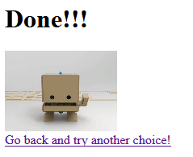
Lab 1 – Raise TJBot’s arm from the web page
Template content is available on your PC ;)
Do I raised my arm?
Why not?
Fix it and expand the project as you like!!!
Notes:
<html><head><title>MENU - Visual recognition Examples FM with ASLTJBot</title></head><body><h1>Node-RED Watson Visual Recognition MENU</h1><p>Examples:<br/><table border='1'><tr> <td> <img src="https://images.pexels.com/photos/145939/pexels-photo-145939.jpeg" height='100'/> <a href="/reco">Show how IBM Watson Image Recognition works</a><br/> </td> <td> <img src="https://www.nature.com/polopoly_fs/7.41086.1481708999!/image/feature1.jpg_gen/derivatives/landscape_630/feature1.jpg" height='100'/> <a href="/faces">Show how IBM Watson Face Recognition works</a><br/> </td></tr><tr> <td> <img src="https://cdn.sparkfun.com//assets/parts/1/2/5/8/8/14515-04.jpg" height='100'/> <a href="/shot">Shot and Recognize objects using TJBot camera</a><br/> </td> <td> <img src="http://www.rttnews.com/ArticleImages/USTopStories/2016/December/IBM-Robot-122916-lt.jpg" height='100'/> <a href="/what">Last recognized objects from TJBot camera</a><br/> </td></tr><tr> <td> <img src="http://aiclubs.org/uploads/1/0/7/3/107309405/published/img-5972.jpeg?1510622717" height='100'/> <a href="/knock">Shot and Recognize face using TJBot camera</a><br/> </td> <td> <img src="https://ibmtjbot.github.io/images/3dprint.jpg" height='100'/> <a href="/who">Last recognized face from TJBot camera</a><br/><br/> </td></tr></table><br/><img src="https://ih0.redbubble.net/image.144251032.5917/sticker,220x200-bg,ffffff-pad,220x200,ffffff.jpg" height='100'/><a href="/">Node-Red Flow Editor</a><br/></p></body></html>

Slide 8
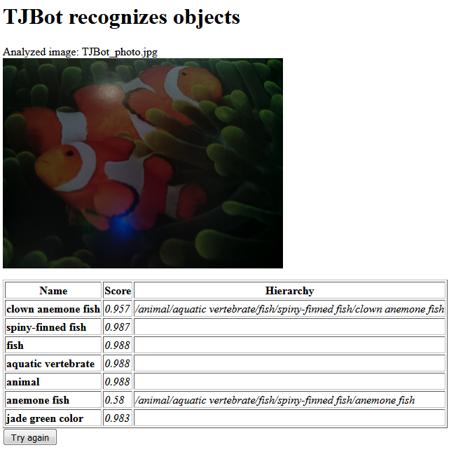
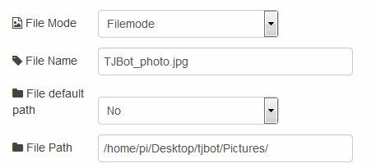

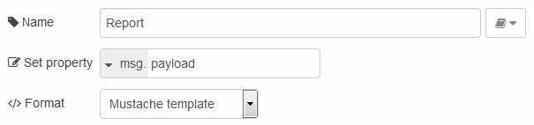
Lab 2 – Analyze image from TJBot’s camera
With a little help from my friends…
Install camera-pi node via Node-Red palette
Take a photo to use in web page response
Use Mustache to build web page template
Modify TJBot configuration adding Visual Recognition credentials
Code and credential are available on your PC ;)
Verify httpStatic in /root/.node-red/settings.js
Notes:
<html><head><title>MENU - Visual recognition Examples FM with ASLTJBot</title></head><body><h1>Node-RED Watson Visual Recognition MENU</h1><p>Examples:<br/><table border='1'><tr> <td> <img src="https://images.pexels.com/photos/145939/pexels-photo-145939.jpeg" height='100'/> <a href="/reco">Show how IBM Watson Image Recognition works</a><br/> </td> <td> <img src="https://www.nature.com/polopoly_fs/7.41086.1481708999!/image/feature1.jpg_gen/derivatives/landscape_630/feature1.jpg" height='100'/> <a href="/faces">Show how IBM Watson Face Recognition works</a><br/> </td></tr><tr> <td> <img src="https://cdn.sparkfun.com//assets/parts/1/2/5/8/8/14515-04.jpg" height='100'/> <a href="/shot">Shot and Recognize objects using TJBot camera</a><br/> </td> <td> <img src="http://www.rttnews.com/ArticleImages/USTopStories/2016/December/IBM-Robot-122916-lt.jpg" height='100'/> <a href="/what">Last recognized objects from TJBot camera</a><br/> </td></tr><tr> <td> <img src="http://aiclubs.org/uploads/1/0/7/3/107309405/published/img-5972.jpeg?1510622717" height='100'/> <a href="/knock">Shot and Recognize face using TJBot camera</a><br/> </td> <td> <img src="https://ibmtjbot.github.io/images/3dprint.jpg" height='100'/> <a href="/who">Last recognized face from TJBot camera</a><br/><br/> </td></tr></table><br/><img src="https://ih0.redbubble.net/image.144251032.5917/sticker,220x200-bg,ffffff-pad,220x200,ffffff.jpg" height='100'/><a href="/">Node-Red Flow Editor</a><br/></p></body></html>

